Slide 1



Seven Years in the Life of Hypergiants’ Off-nets
Petros Gigis¹
Matt Calder^{2,3}, Lefteris Manassakis⁴, George Nomikos^{4,5}, Vasileios Kotronis⁴,
Xenofontas Dimitropoulos^{4,6}, Ethan Katz-Bassett³, Georgios Smaragdakis⁷
¹ University College London, ² Microsoft, ³ Columbia University,
⁴ FORTH-ICS, ⁵ Lancaster University, ⁶ University of Crete, ⁷ TU Delft
ACM SIGCOMM, August 2021

Slide 2
Hypergiants and Traffic Consolidation
January 2009 - 2019
In 2019, 5 sites contribute 50% of traffic!
In 2016, 10 of ASes contribute 50% of traffic!
In 2009, 150 of ASes contribute 50% of traffic!
In 2007, 1,000s of ASes contribute 50% of traffic
2000 ASN == 50%
2007
150 ASN == 50%
2009
5 HG == 50%
2019
Source: Internet Traffic 2009-2019, C. Labovitz.
2

Slide 3
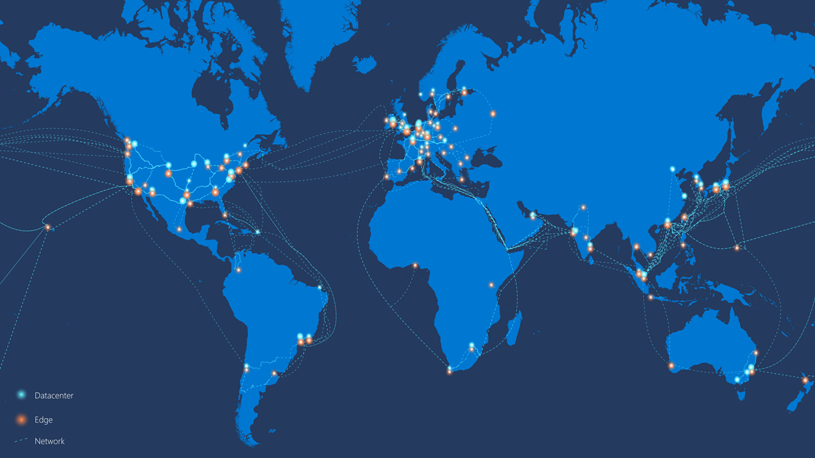
Microsoft’s Azure Global Network
Peer at IXPs and
collocation facilities
Construct datacenters
Deploy off-net servers
Peer directly
with eyeballs
Roll out fiber to
built their backbone
Source: Microsoft (January 2020)
3

Slide 4



Hypergiant’s off-net footprint
Hypergiant AS(es)
ISP AS
Server-to-Server
connection
End User
Hypergiant
on-net server
Hypergiant
off-net Server
AS-level peering
On-net: A server deployment
inside the HG own network.
Off-net: A server deployment
outside of the HG own network.
4

Slide 5


Why measure Hypergiant’s Off-nets?
HG
Peering link
ISP
Revisit the value of peering and how traffic flows in the Internet.
Understand the evolution of the Internet structure.
Localisation of content within an Internet Service Provider (ISP).
Performance potential for emerging networks (e.g., ).
5

Slide 6
How to measure Hypergiant’s Off-nets?
Traditional techniques (e.g., IP-to-AS mapping) do not work.
Existing approaches^{[1.2]} to discover off-nets lack generality and are fragile to HG changes. [1] “Mapping the Expansion of Google’s Serving Infrastructure”, Calder et. al., IMC 2013 [2] “Open Connect Everywhere: A Glimpse at the Internet Ecosystem through the Lens of the Netflix CDN”, Böttger et. al., CCR 48
So, is there a generic method to uncover the off-nets of all Hypergiants?
Surprisingly, yes!
6

Slide 7
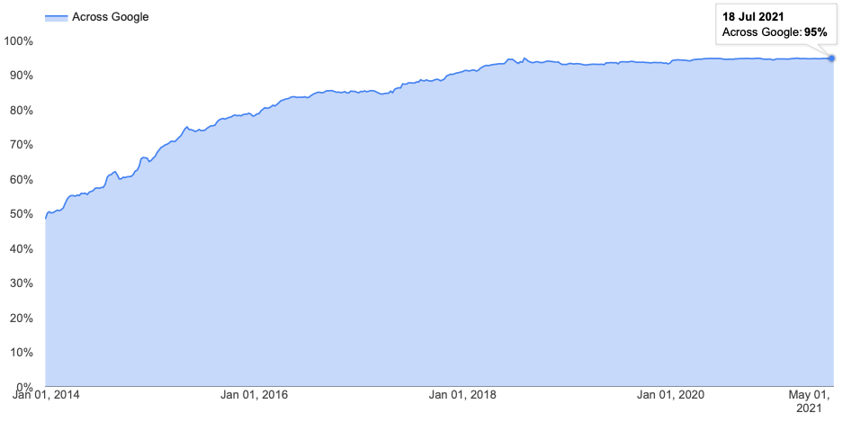
Encrypted traffic is the new standard
The majority of the traffic is encrypted.
Enabling change: encrypted traffic is the new standard
Using TLS certificates we can find the service owner.
Corpuses of TLS data are publicly available.
Source: Google Transparency Report
7

Slide 8



Contributions
We developed the first technique capable of uncovering the off-net footprint deployment of all Hypergiants.
We applied it to map their growth from 2013 to 2021.
We found that grew by 2,766 ASes, reaching 3,810 in April 2021.
and launched their own CDNs and now have presence in at least 2,115 ASes.
8

Slide 9
What this work is not about:
Not a head-to-head comparison of different HGs as we do not know:
Business strategies.
Peering agreements.
Performance and cost goals.
Performance evaluation of different HG off-net footprints is out of the scope of this work.
In this work, we focus only on uncovering the off-net deployments.
9

Slide 10



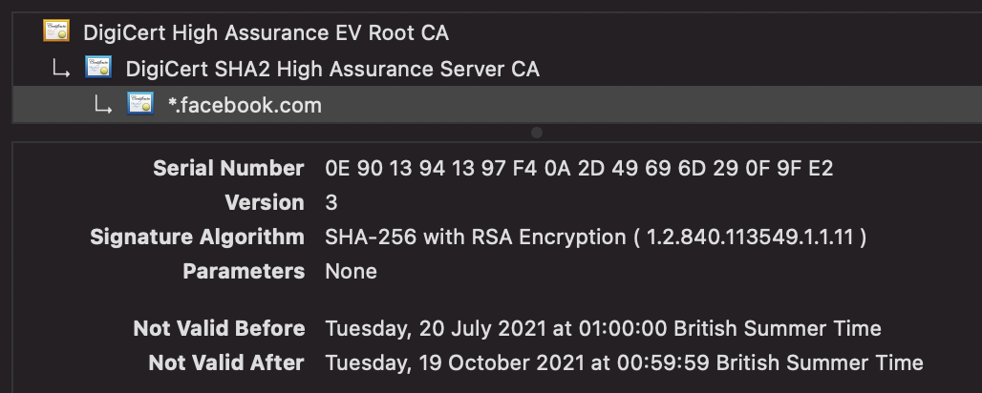
Methodology
Step 0: Collect TLS certificates dataset
Step 1: Validate Certificates
Exclude self-signed, expired and certificates with a non-verified chain.
Valid TLS Certificates
TLS Certificates Dataset
10

Slide 11



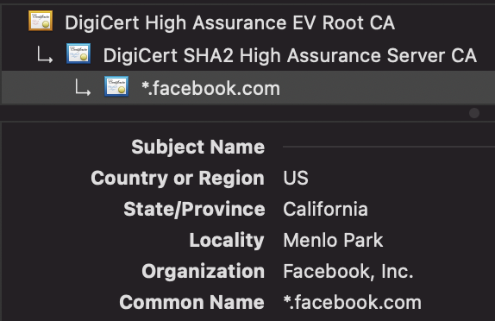
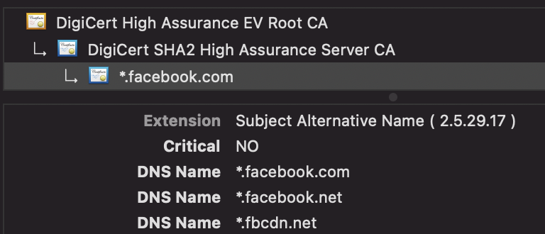
Methodology
Step 2: Learn Hypergiant TLS Fingerprints
Input the HG keyword e.g., “facebook” and the TLS scans for all on-net IPs.
Facebook AS(es)
On-net TLS
Fingerprints
Valid TLS Certificates
11

Slide 12
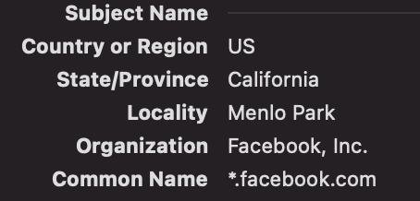

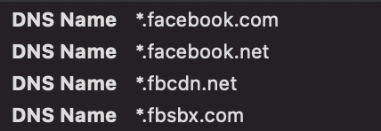
Methodology
Step 3: Use Fingerprints to Identify candidate off-nets
Search for certificates matching the on-net fingerprints.
AS1
AS3
On-net TLS
Fingerprints
Candidate off-net
server deployments
AS2
12

Slide 13


Challenges
Does presence of a Hypergiant certificate on a server outside their own network guarantee that the server is an off-net server deployment?
No, it does not!
off-nets
AS(es)
The server is owned by Akamai
and used by Facebook
Akam. off-net servers used by Facebook
13

Slide 14


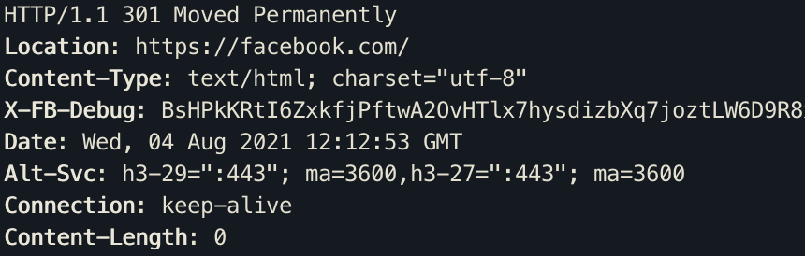
Methodology
Step 4: Learn Hypergiant HTTP(S) Fingerprints using headers
GET HTTP (80)
HTTP header
Fingerprint
AS2
AS3
HTTPS header
Fingerprint
GET HTTPS (443)
AS1
14

Slide 15

Methodology
Step 5: Confirm Candidates Using HTTP(S)
Apply the HTTP(S) fingerprints to the off-net candidates and classify as off-nets any that match the HG fingerprints.
HTTP header
Fingerprint
Candidate off-net
server deployments
Off-net
server deployments
HTTPS header
Fingerprint
15

Slide 16
Technique Outline
The TLS certificate reveals if an IP hosts a service for the Hypergiant.
HTTP(S) header reveals who operates the server.
The IP address reveals if it is an on-net or off-net server.
To consider a server as a Hypergiant off-net deployment:
TLS certificate and HTTP(S) headers must map to the Hypergiant.
The IP address is not part of the Hypergiant own network.
16

Slide 17


Datasets
TLS certificate scans:
collects certificates in IPv4-wide scans on port 443.
Quarterly snapshot from Oct. 2013 to Apr. 2021.
+ Custom active scan.
HTTP(S) headers (Validation):
We used corpuses of available HTTP(S) headers from Rapid7 from Oct. 2013 to Apr. 2021.
17

Slide 18
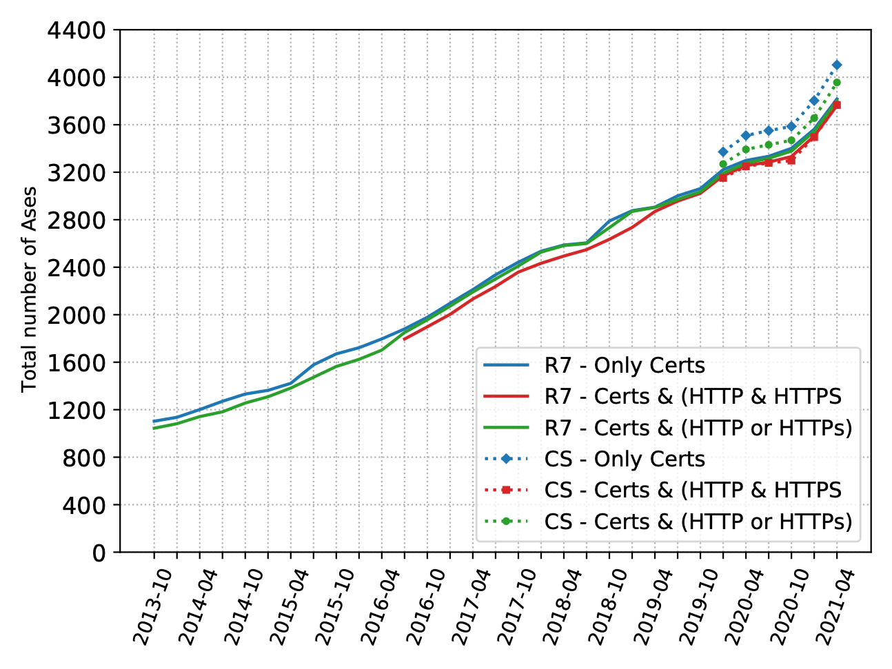
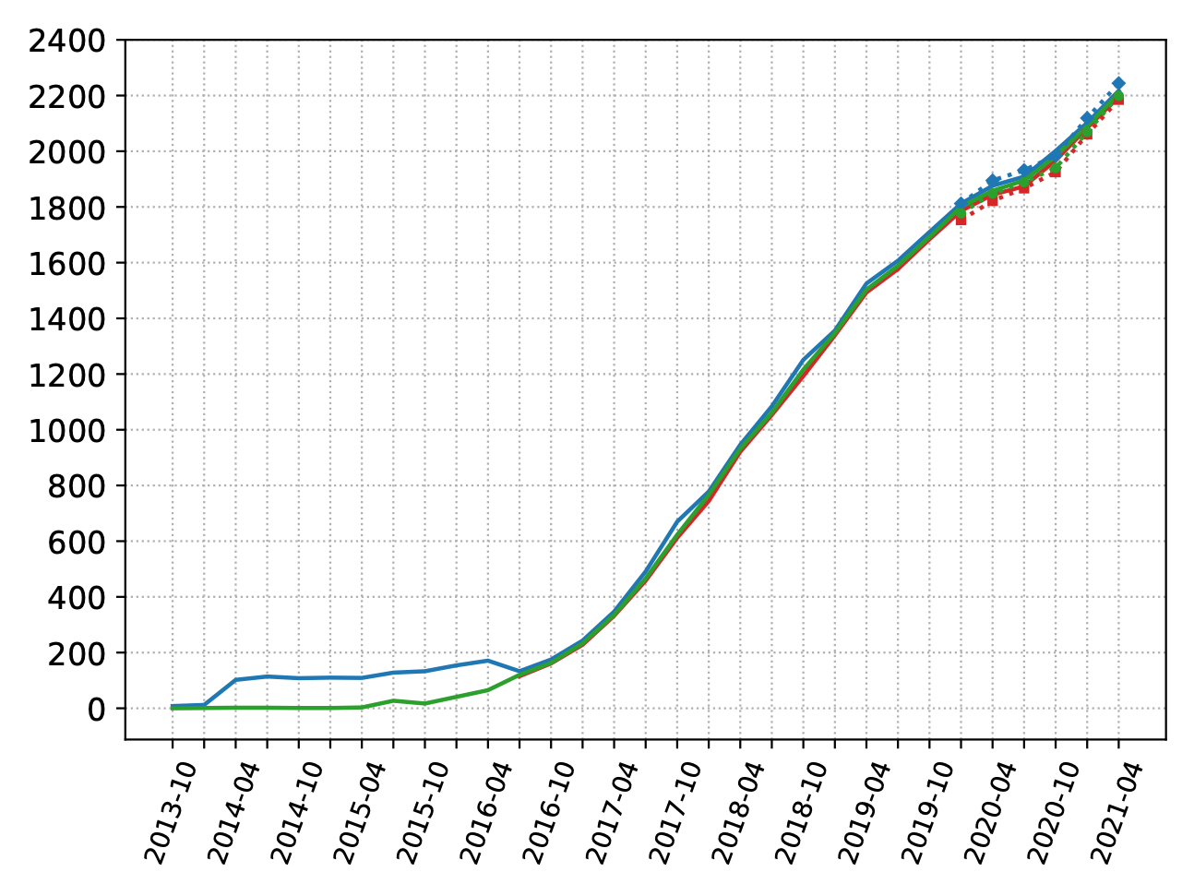
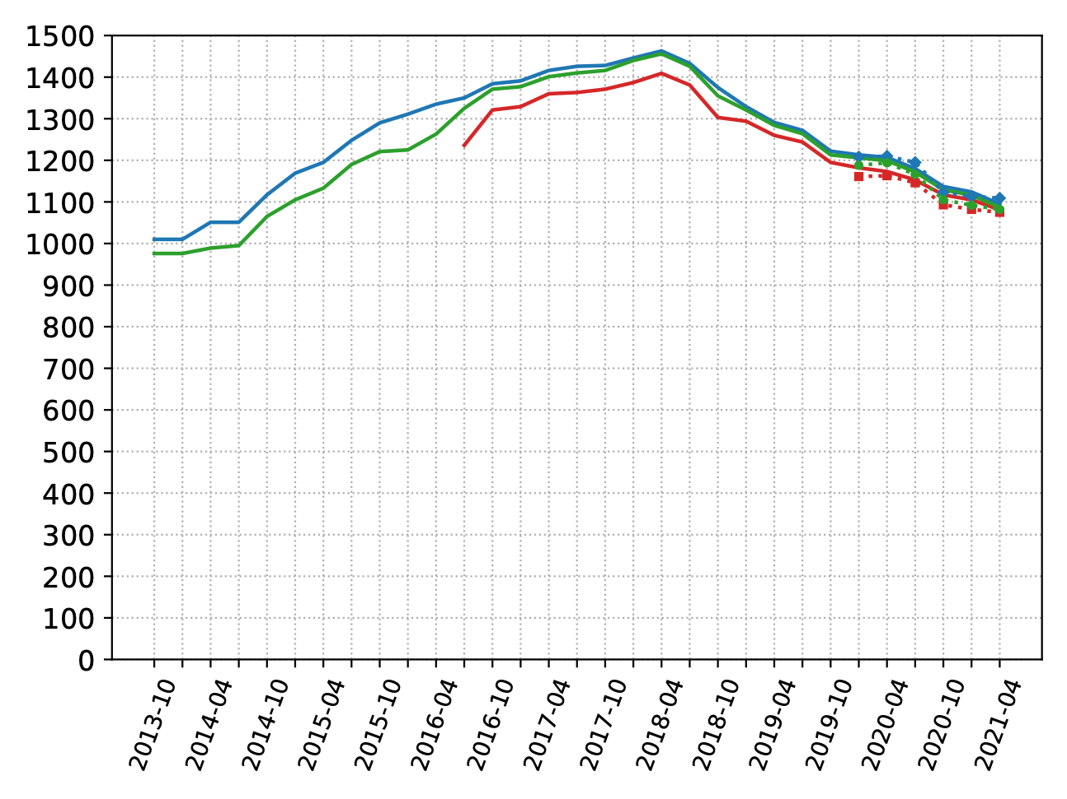
Dataset and HTTP(S) header validation
Differences between only-certificates and &/or HTTP(S) are minimal.
For using we are able to identify more ASes.
18

Slide 19
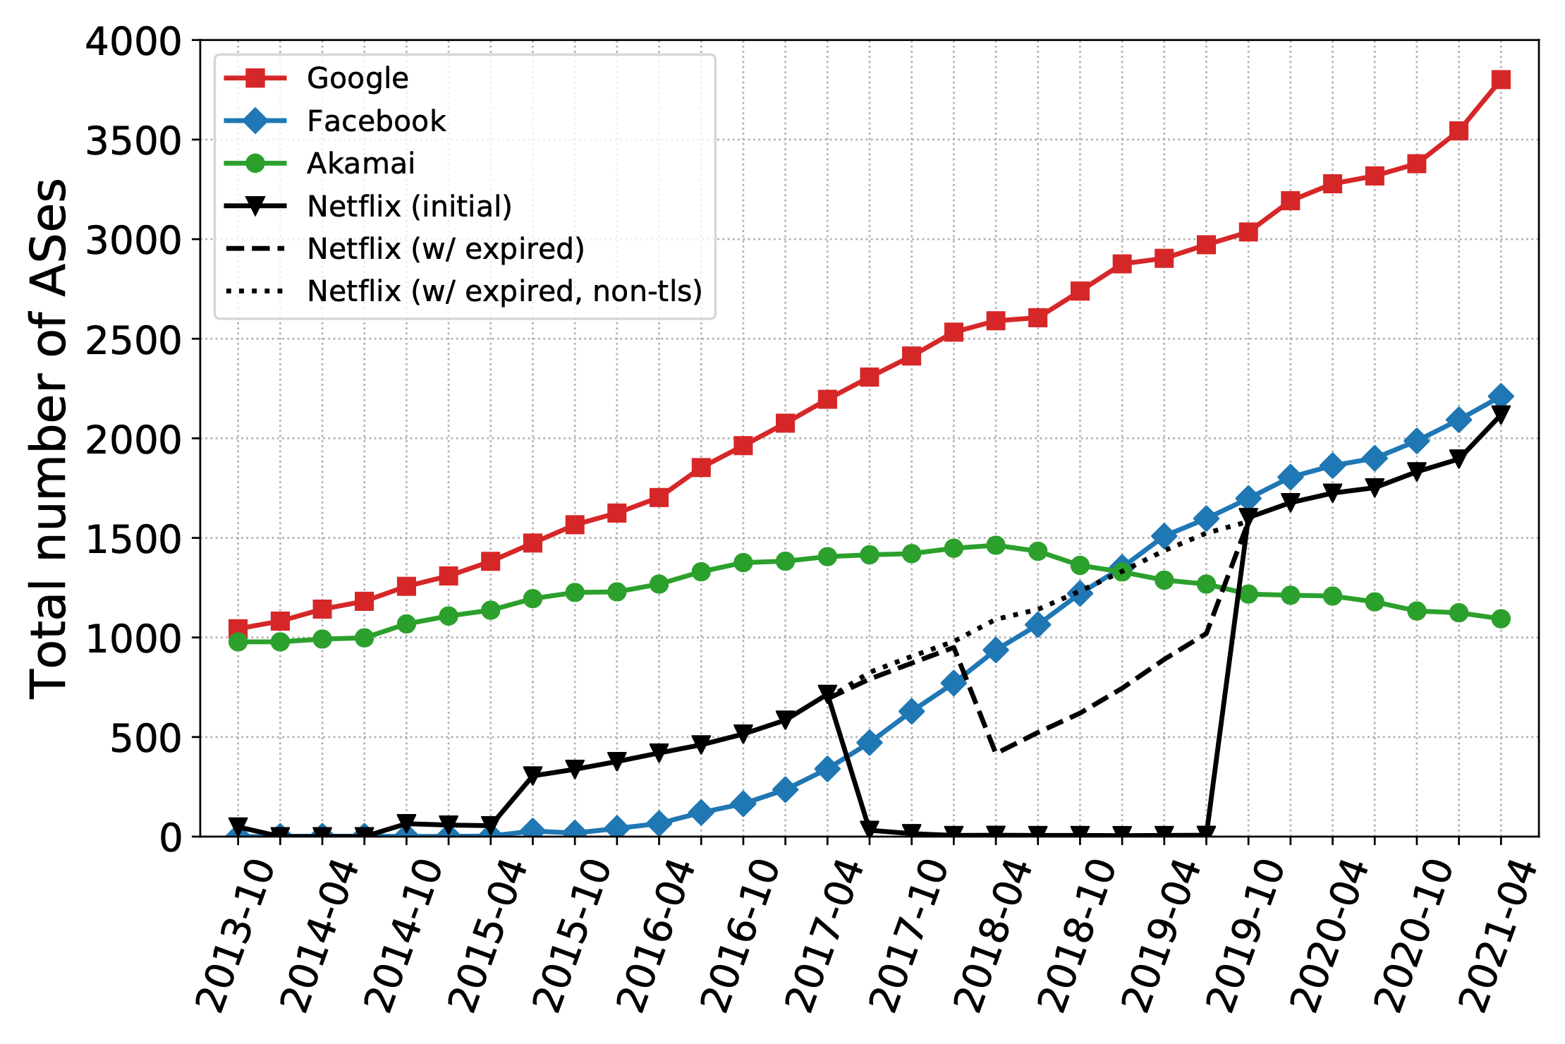
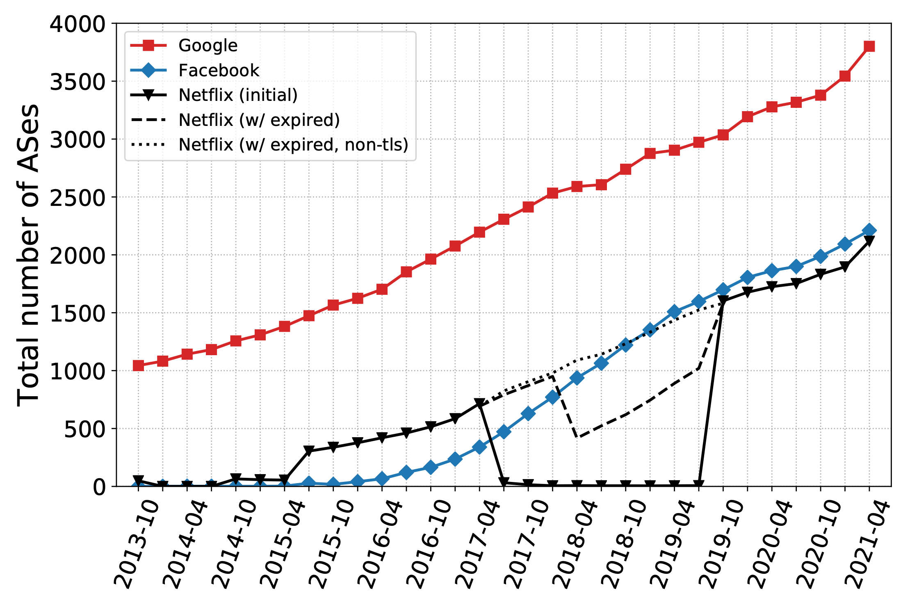
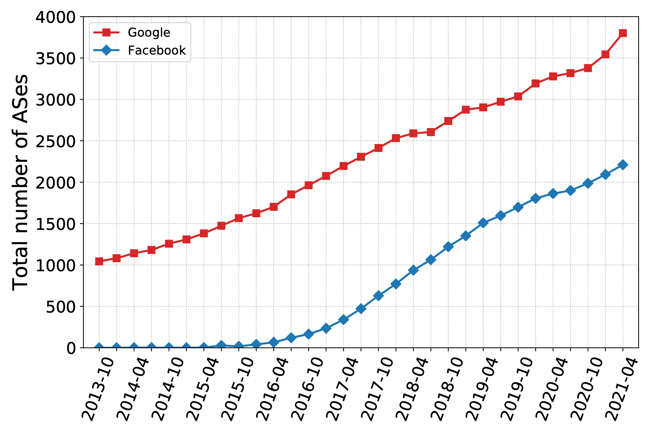
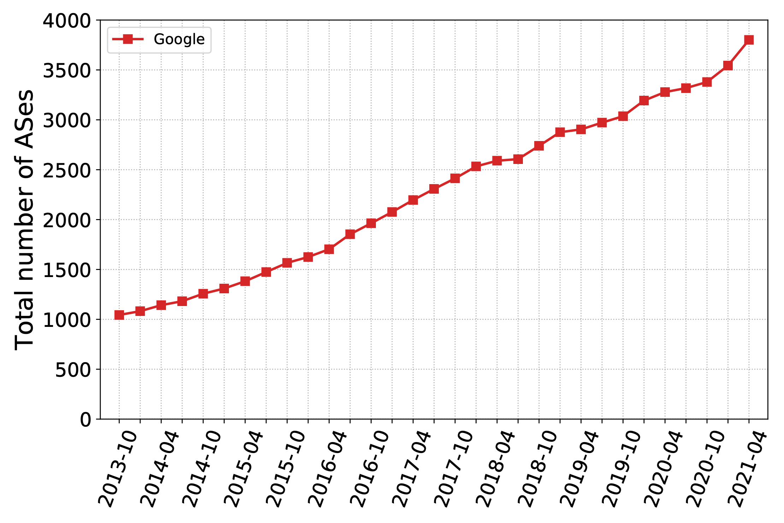
Hypergiants’ off-nets Expansion
Longitudinal Growth (2013-2021)
Google has off-nets
in more than 3.8k ASes
Period Netflix switched
to only HTTP
Birth of a CDN
Off-net footprint growth for top-4 HGs (Google, Facebook, Netflix and Akamai) over time.
19

Slide 20
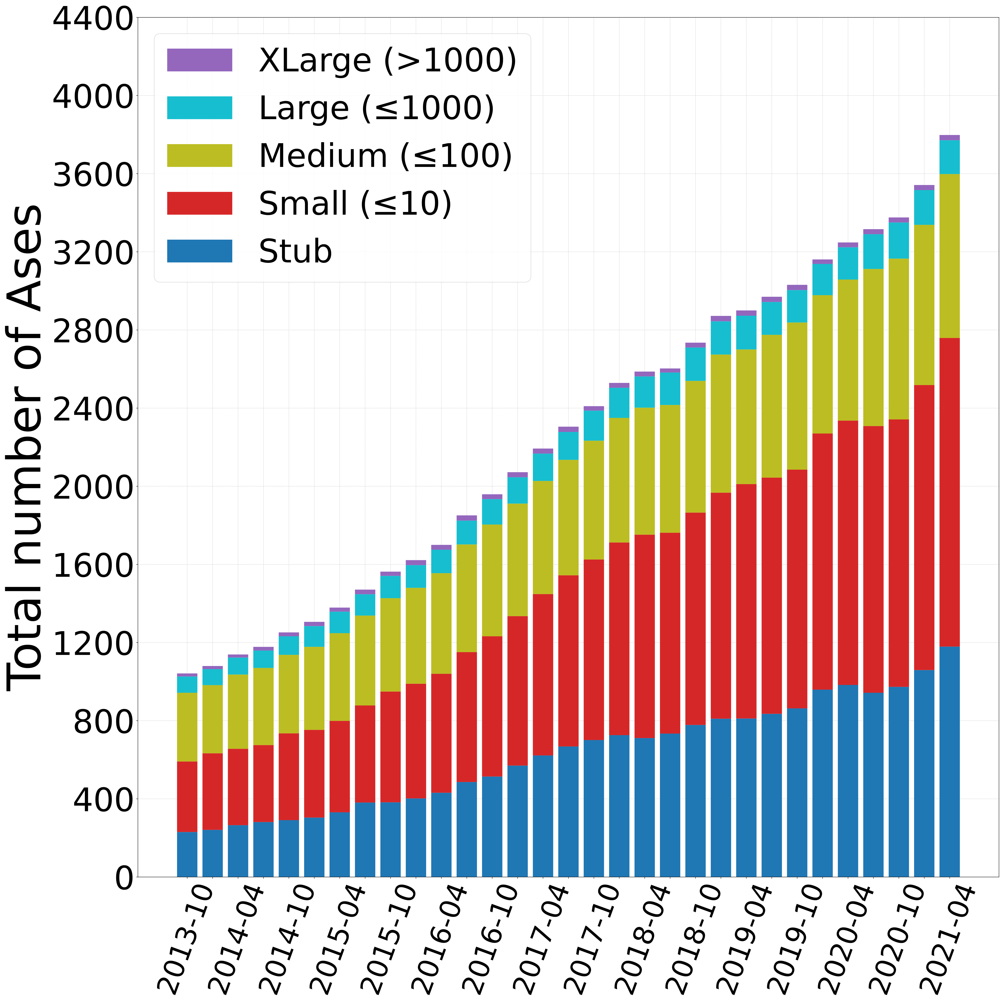
Growth by Network Type
Understanding the “demographics” (Mode I)
We label the ASes hosting off-nets based on their customer cone size*.
We consider 5 categories of ASes:
Stub (no cone)
Small (≤ 10 Ases)
Medium (≤ 100 ASes)
Large (≤ 1000 ASes)
XLarge (> 1000 ASes)
4x increase in Stub, Small and, Medium ASes.
2x increase in Large and XLarge ASes.
Growth significantly increase after the open of the economy.
* Extracted from the CAIDA AS Relationships Dataset.
20
Growth of Google’s off-net footprint grouped by AS customer cone size.

Slide 21
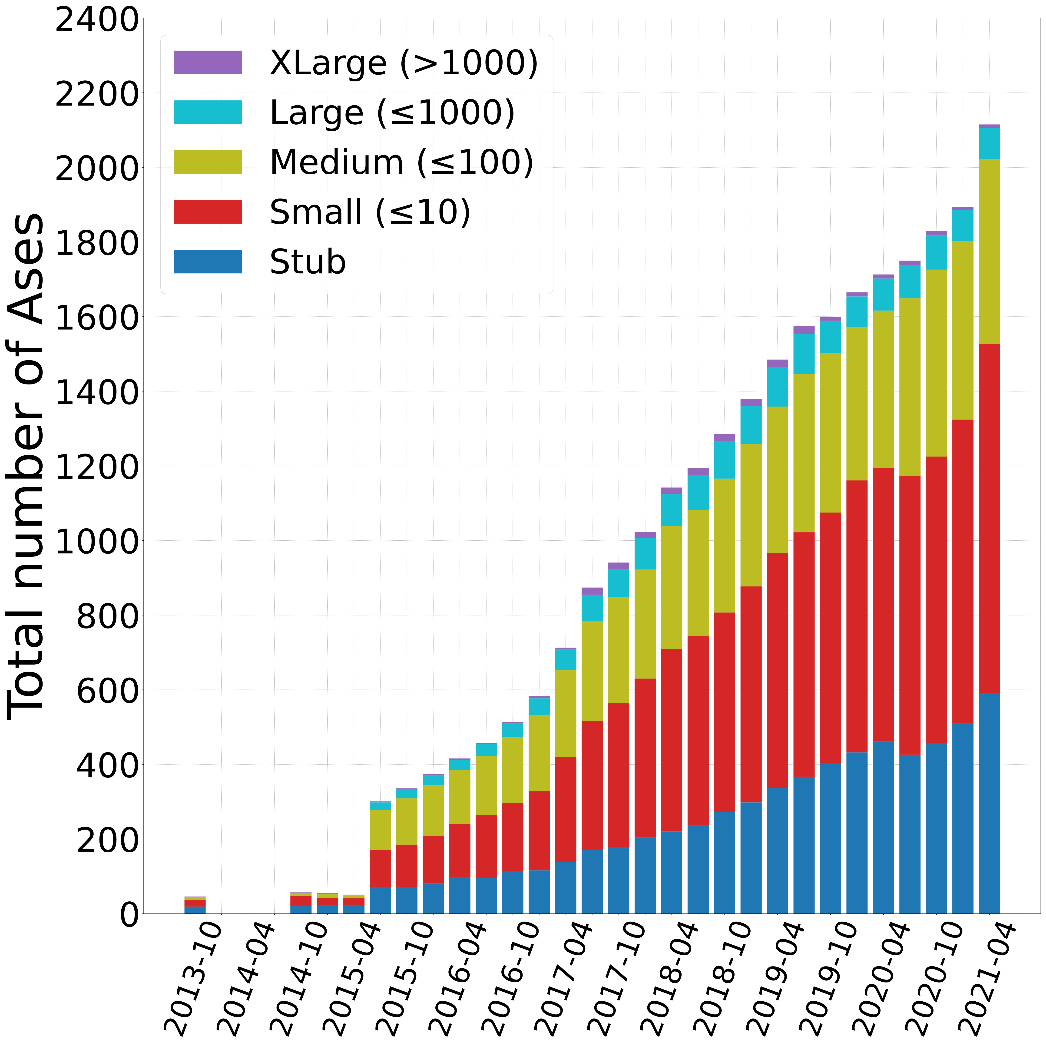
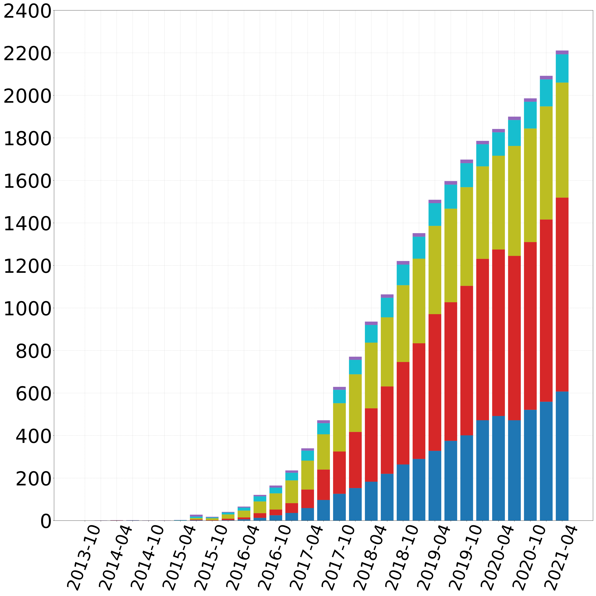
Growth by Network Type
Understanding the “demographics” (Mode II)
Birth of HG CDNs.
More aggressive increase 10x.
Similar contributions of different types of networks.
Significant increase after the lockdown.
Growth of Netflix and Facebook off-net footprints grouped by AS customer cone size.
21

Slide 22
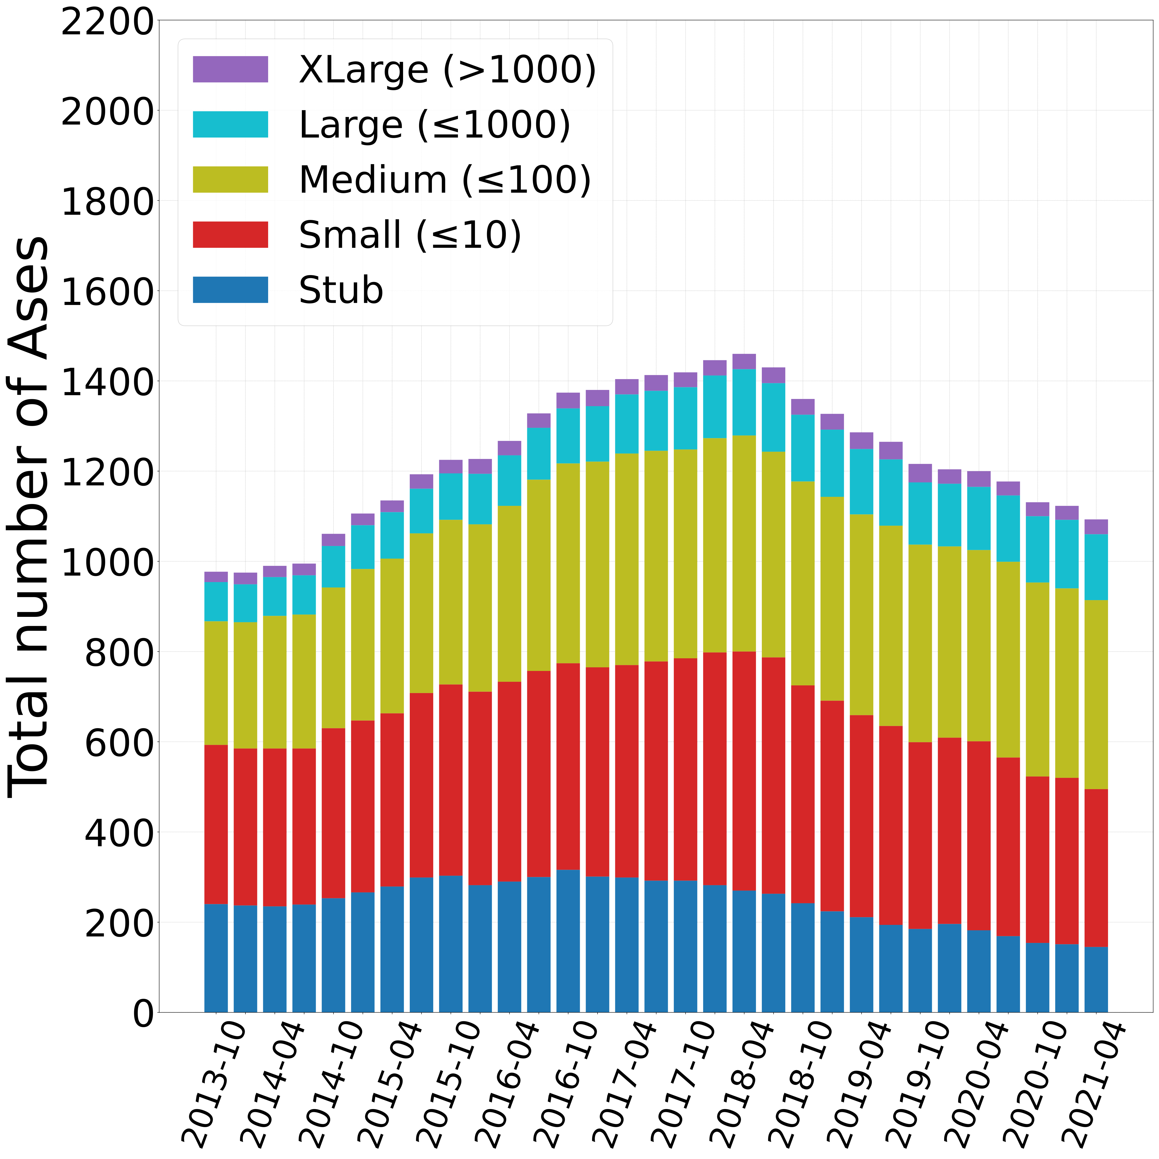
Growth by Network Type
Understanding the “demographics” (Mode III)
Contribution of stub ASes since 2018 decline.
Contribution of small & medium remain stable.
Sum of stub, small and medium remains 84%.
Growth of Akamai’s off-net footprint grouped by AS customer cone size.
22

Slide 23
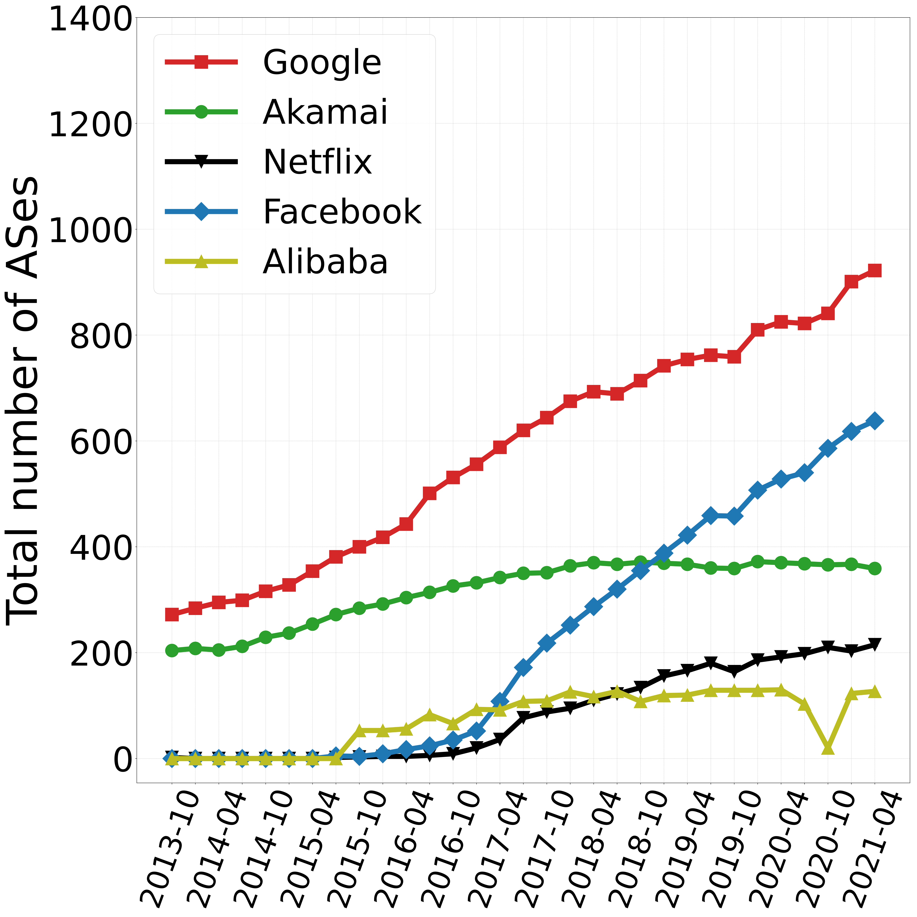
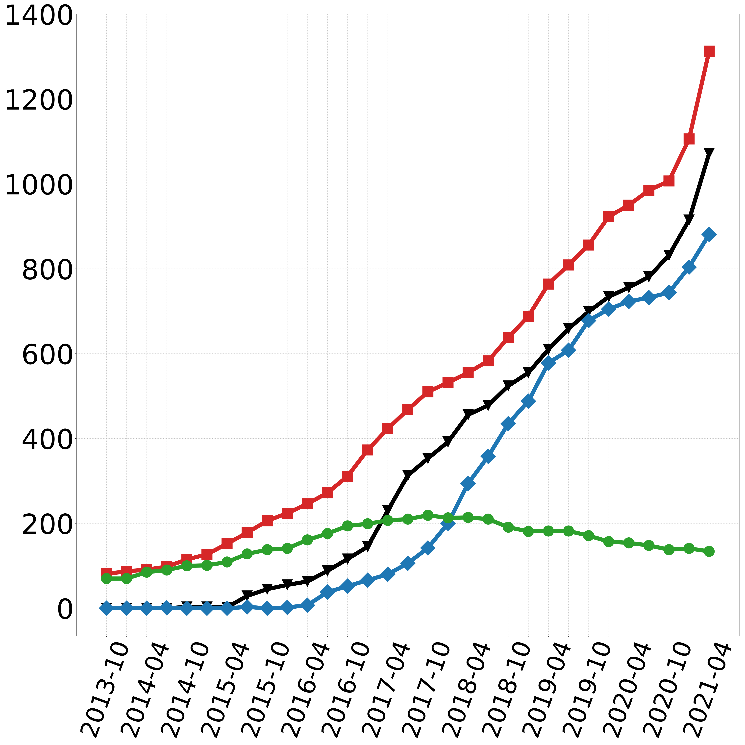
Regional Growth
Asia
South America
Significant increase of all HGs (except Akamai) in all regions.
Most significant increase in Asia and South America.
Regional growth of some HGs (e.g., Alibaba in Asia).
Growth of top-4 HGs (plus Alibaba) in Asia and South America continent over time.
23

Slide 24


APNIC Internet User Population Estimates
APNIC conducts measurement campaigns ( ) to estimate the user population per AS.
Uses data to normalise findings.
The only available dataset that provides this type of information.
Daily snapshots from October 2017 to date.
Source: How Big is that Network? | labs.apnic.net
24

Slide 25
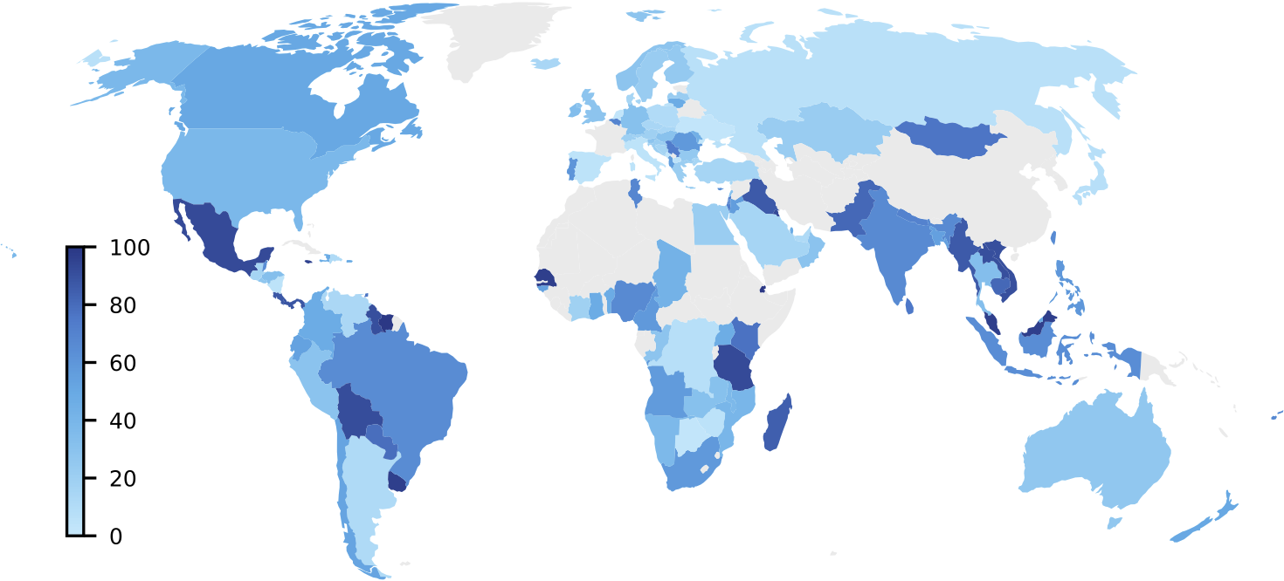
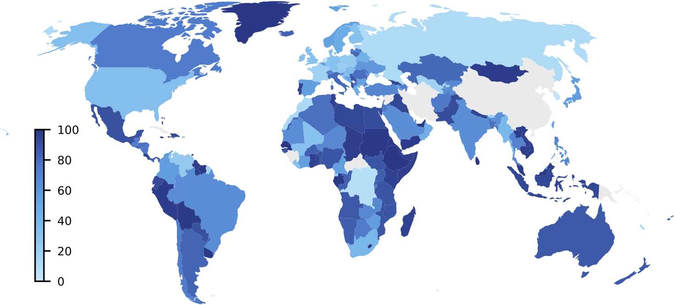
Hypergiants’ off-nets Expansion
Internet User Population Coverage over time
Mexico: 90%
46% increase in global user coverage
Mexico: 90%
Argentina: 15%
October 2017 : 34.2%
Argentina: 80%
April 2021: 49.8%
Facebook’s off-net footprint user coverage (%).
Example: Facebook in 2017 announced that it had plans to expand in Africa and other developing regions.
Our analysis reflect that they achieved this goal.
25

Slide 26
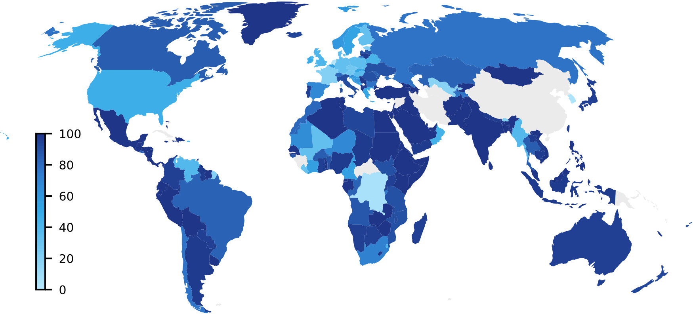
Hypergiants’ off-nets Expansion
Internet User Population Coverage based on customer cone
27% increase in global user coverage
Google
Netflix
Include Customer Cone : 63.2%
April 2021: 49.8%
Exclude Customer Cone : 49.8%
% of a country’s Internet users including and excluding the customer cones of ASes hosting Facebook off-nets (April 2021).
What-If #1: Serving into the customer cone noticeably expands coverage in parts of Africa, Asia, Europe and South America.
What-If #2: Facebook coverage could significantly increase in the US from 33.9% to 61.8% by deploying off-nets in only 5 ASes.
26

Slide 27
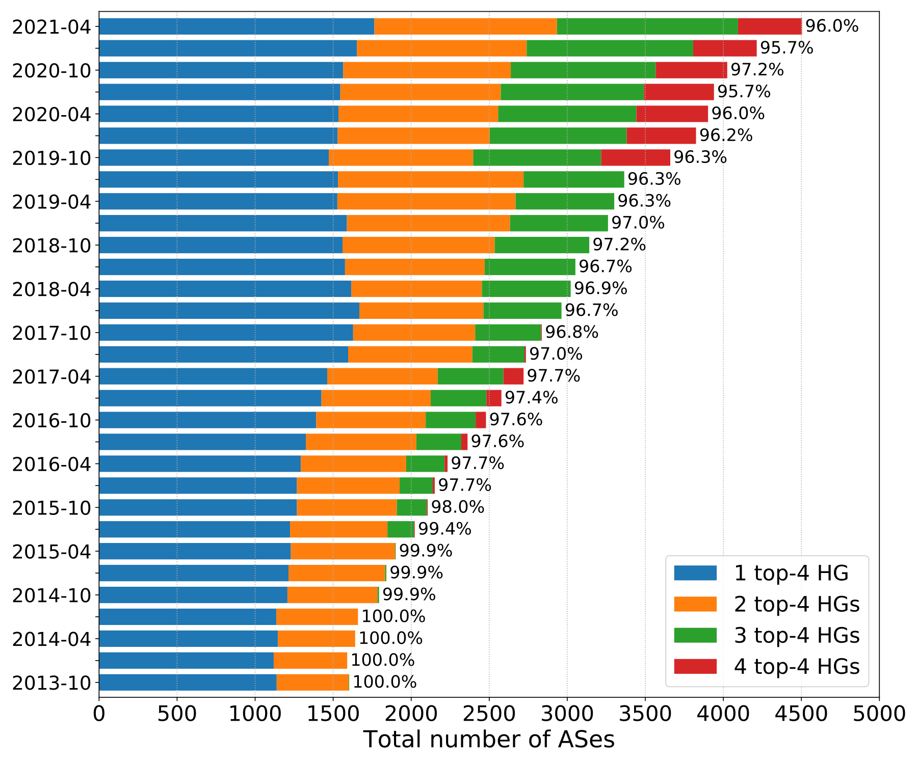
Network Providers’ Hosting Strategies
More than 97% of ASes hosting off-nets, host at least one of the top-4 HGs.
Top-4 HGs have increasingly similar footprints.
In 2021, more than 70% of ASes with off-nets host 2-4 top-4 HGs.
In 2013, it was less than 30%.
A networks that already hosts one of the top-4 HGs is likely to later host more.
ASes that host at least one top-4 HGs.
27

Slide 28
Validation
Validation from Hypergiants.
Four replied to our survey, all of them indicated that we correctly uncovered 89-95% of ASes hosting their off-nets.
Comparison to Earlier Results.
: Previous study in April 2016 reported 1445 ASes. We identified 98% of them, plus 283 additional ASes.
: Comparison with three studies: We identified 96% (2018), 94% (2019) and 95% (2021) of the ASes.
: Previous study in May 2017 reported 743 ASes, we report 769 ASes.
28

Slide 29


Limitations
TLS-SNI.
Multiple TLS certificates in a single IP address.
Missing Headers.
Default HTTP(S) headers (e.g., ).
Special Architectures by HGs.
HGs acting as middleware proxies (e.g., ).
29

Slide 30
Discussion
An Increasingly Private Internet.
Regulatory implications.
ISPs lose negotiation power in peering agreements with HGs.
Small networks reduce cost as upstream/downstream traffic is reduced.
Unintended Consequences.
Knowing HGs off-net servers makes it easier for attackers to be effective.
Business intelligence by competitors.
Hide-and-Seek.
Increase the bar for server identification by implementing TLS-SNI.
30

Slide 31
Takeaways
Large content providers serve most of the traffic on today’s Internet. To send this traffic, some of them host off-net servers in user ASes around the world.
Generic methodology to uncover off-net deployments.
Significant growth of 3 ( , , ) out of 4 top HGs, hosted in more than 4.5k ASes.
Significant fraction of user population can be served by off-nets in their ISP.
Study of ISPs wiliness to host HG off-nets.
Artifacts, datasets, and an interactive portal are available at:
https://pgigis.github.io/hypergiants-offnets/
31

